Slide 1
UART
Group members:
Chethan Kumar
Suneel Eerla
Balachandrudu
Deepa Angadi

Slide 2
INTRODUCTION
UART was developed by Gordon Bell at Digital Equipment Corporation in 1960.
It is a physical circuit in Microcontroller or a stand alone IC.
It allows communication with modems or other external devices.
It is a Asynchronous Serial Data communication.

Slide 3
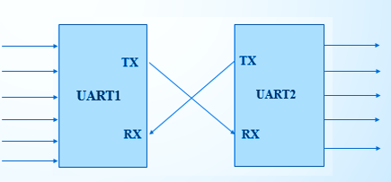

Transmitter side uart converts parallel data into serial data.
Receiver side uart converts serial data into parallel data.

Slide 4
Modes of communication
Simplex.
Half duplex.
Full duplex.

Slide 5
MODES OF UART
UART operates on 2 different modes
Half duplex mode.
Full duplex mode.

Slide 6
VERSIONS OF UART
TYPES OF UART | FIFO SIZE (byte) | SPEED
8250 (8250A,8250B) | 1 | 9.6 kbps
16450 | 1 | 19.2 kbps
16550(16550A) | 16 | 115.2 kbps
16650 | 32 | 460.8 kbps
16750 | 64 | 921.6 kbps
16850 | 128 | 1.5 Mbps

Slide 7
BAUD RATE
The no of symbols transmitted per second is called Baud rate.
For 16550 the baud rate should be 115200bps.
Time taken for 1 bit =1/115200=8.605us

Slide 8
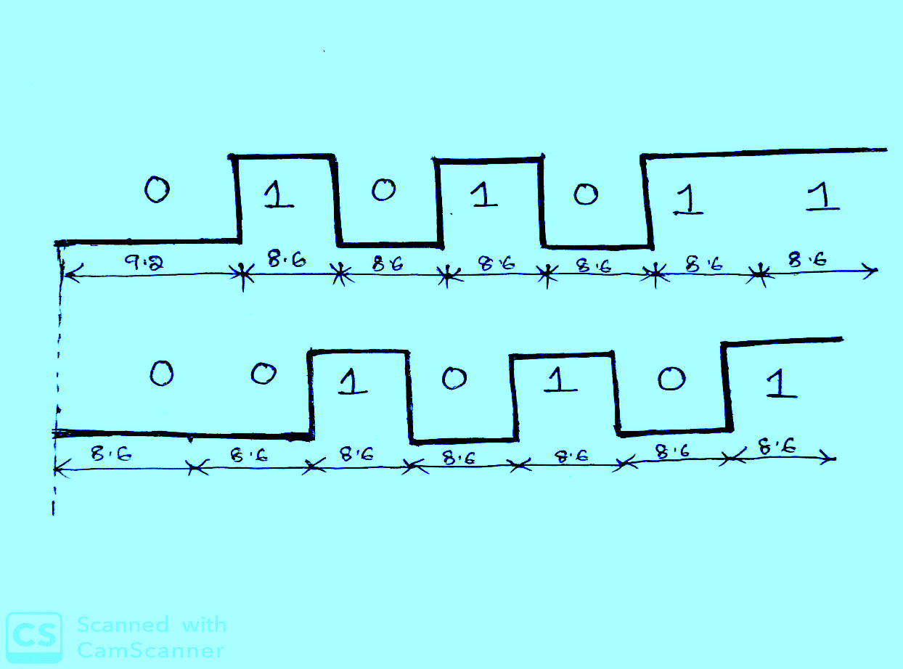
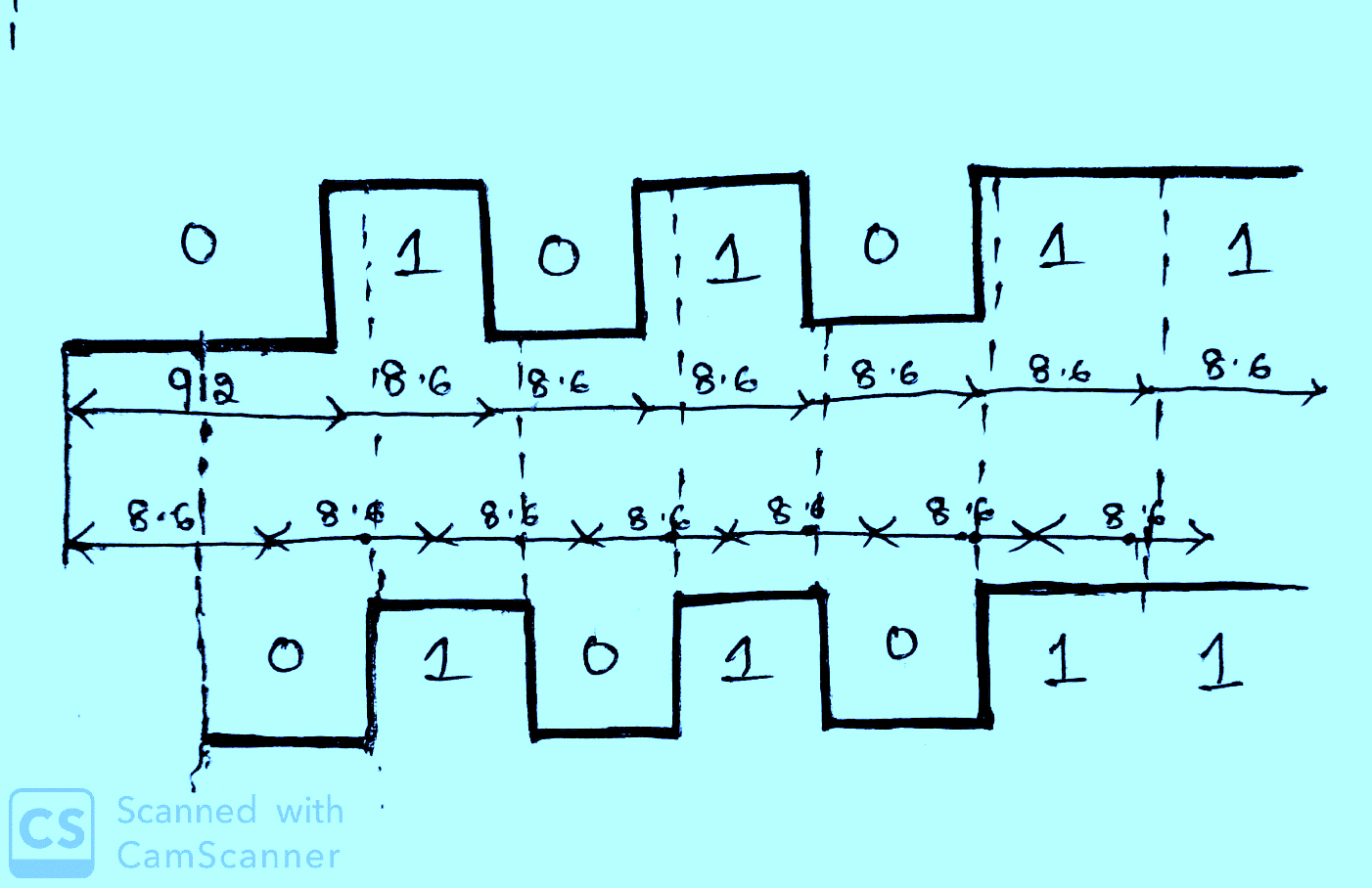
Why receiver sampling at mid of the bit?
Rx sampling bit at first
Rx sampling bit at mid
TX data : 0101011
TX data : 0101011
RX data : 0010101
RX data : 0101011

Slide 9
What happens if TX & RX operates different baud rates
Example:
TX Baudrate =100 =1/100=0.01sec
RX Baudrate =200 =1/200=0.05sec

Slide 10
DIVISOR LATCH VALUE
Divisor latch register is used to determine which baud rate that the uart is going to transmitting the data.
Used for generation of baud clk in baud generator.
System Clock Frequency(SCF)=10ns=1/10=0.1mhz, Baudrate=115200
Divisor value =
System clk Freq
=
100Mhz
Baud rate *16
115200*16
Divisor value = 54.25

Slide 11

BAUD CLK GENERATION
UART contains a Baud generator that takes input clock
and divides the input clock by a divisor value to produce
a baud clock
Input clock
0
54
108
Baud clock

Slide 12
UART FRAME STRUCTURE
Data in uart is organized into blocks called Frames
UART FRAME
START BIT [1] | PAYLOAD [5 -8] | PARITY BIT [1] | STOP BIT [1]

Slide 13
START BIT: The start bit indicates the beginning of data.
PAYLOAD: Length of data frame should be 5 to 8 bits.
PARITY BIT: To check whether the received data is correct or not.
STOP BIT: The stop bit indicates the end of data.

Slide 14
REGISTERS LIST
Name | Address | Width | Access | Description
Receiver Buffer | 0 | 8 | R | Receiver FIFO output
Transmitter Holding Register (THR) | 0 | 8 | W | Transmit FIFO input
Interrupt Enable | 1 | 8 | RW | Enable/Mask interrupts generated by the UART
Interrupt Identification | 2 | 8 | R | Get interrupt information
FIFO Control | 2 | 8 | W | Control FIFO options

Slide 15
REGISTERS LIST
Name | Address | Width | Access | Description
Line Control Register | 3 | 8 | RW | Control connection
Modern Control | 4 | 8 | W | Controls modem
Line Status | 5 | 8 | R | Status information
Modern Status | 6 | 8 | R | Modern Status
Divisor Latch Byte 1 (LSB) | 0 | 8 | RW | The LSB of the divisor latch
Divisor Latch Byte 2 | 1 | 8 | RW | The MSB of the divisor latch

Slide 16
LINE CONTROL REGISTER(RW)
DIVISOR LATCH | BREAK CONTR0L | STICKY PARITY | EVEN or ODD PARITY | PARITY EN | STOP BIT | DATA SEL BIT
0-REGacess 1- DL acess | 0- Disabled 1- Enabled | 0- Disabled 1- Enabled | 0-Odd parity 1-Even Parity | 0- No parity bit 1- Parity bit | 0- 1stop bit 1- 1.5 stop bit or 1-2 stop bits | 00-5bits 01-6bits 10-7bits 11-8bits
7
6
5
4
3
2
1
0

Slide 17
FIFO CONTROL REGISTER(W)
00-1 byte 01-4 byte 10-8 byte 11-14 byte | Ignored | Ignored | Ignored | 1 – clears the TX FIFO 0 – doesn't clears the TX FIFO | 1 – clears the RX FIFO 0 – doesn't clears the RX FIFO | 0 –non FIFO mode off 1 – FIFO mode on
7
6
5
4
3
2
1
0

Slide 18
LINE STATUS REGISTER(R)
0- No errors in FIFO 1 – At least one error in FIFO | 0-THR not Empty 1-THR Empty | 0-Fifo not empty 1-Fifo empty | 0-Break condition 1-No break condition | 0- Framing error 1-No Framing error | 0- No parity error 1- Parity Error | 0- No Overrun error 1-Overrun error | 0-Fifo empty 1-At least 1 character in FIFO
7
6
5
4
3
2
1
0

Slide 19
INTERRUPT REGISTERS
Interrupt registers are used to enable and identify the interrupt
1.Interrupt Identification Register
2.Interrupt Enable Register

Slide 20
INTERRUPT ENABLE REGISTER(RW)
RESERV ED | RESERVED | RESERVED | RESERVED | MODEM STATUS INTR | RX LINE STATUS INTR | THR EMPTY INTR | RX DATA AVAILABLE INTR
LOGIC-0 | LOGIC-0 | LOGIC-0 | LOGIC-0 | 0- Disabled 1- Enabled | 0- Disabled 1- Enabled | 0- Disabled 1- Enabled | 0- Disabled 1- Enabled
7
6
5
4
3
1
0
2

Slide 21
INTERRUPT IDENTIFICATION REGISTER(R)
RESERV ED | RESERVED | RESERVED | RESERVED | INTERUPT TYPE | BIT
LOGIC-1 | LOGIC-1 | LOGIC-0 | LOGIC-0 | 000-Modem status INTR 001-THR empty INTR 010-RX data INTR 011-RX status INTR 110-Time out INTR | 0-INTR Pending 1- No INTR Pending
7
6
5
4
3
2
1
0

Slide 22
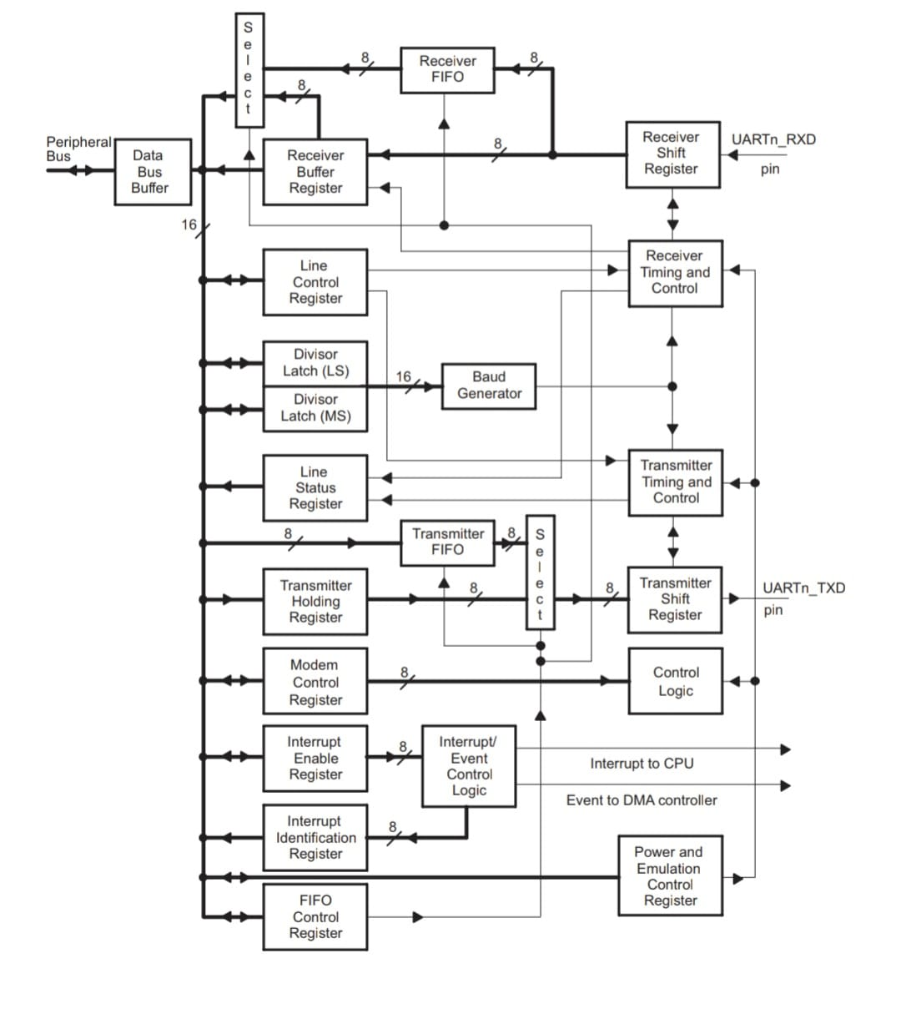
UART BLOCK
DIAGRAM

Slide 23
FEATURES
No. of buses required : 2
BaudRates:1200, 2400, 4800, 9600, 19200, 38400, 57600, 115200, 230400, 460800, 921600
Data size =5 to 8 bits
Parity bit=1
Stop bits=1,1.5,2

Slide 24
ADVANTAGES
It requires only two wires for data communication.
CLK signal is not required.
It includes a parity bit for allowing to check the errors.

Slide 25
DISADVANTAGES
Size of data frame is limited to 8-bits.
Transmitter and receiver both must be agree on same baud rates.
Parity bit is only used for one bit error checking.

Slide 26
APPLICATIONS
Used between Computers to Peripheral Devices.
Microcontrollers.
Modems, Printers.
LCDS.

Slide 27
Thank you

